Slide 1
With great power comes great responsibility: Using data and analytics to facilitate student success
Luisa M. Havens Gerardo, Ph.D. Vice Provost for Enrollment Management
Credit: Freeda / Shutterstock © 2019 in https://er.educause.edu/articles/2019/1/top-10-it-issues-2019-the-student-genome-project

Slide 2
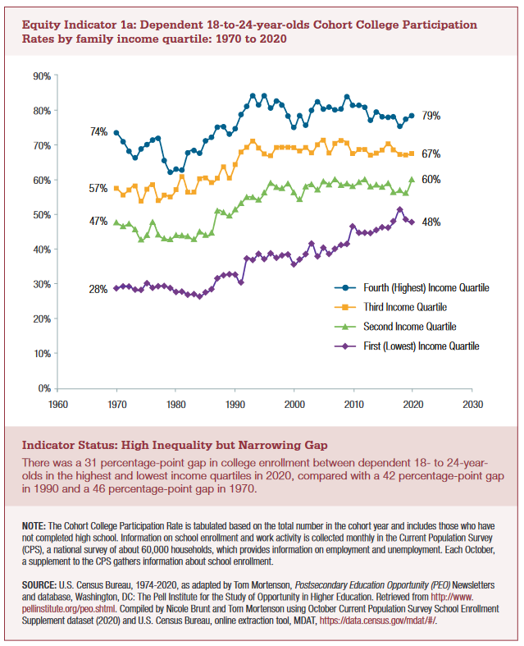
http://pellinstitute.org/indicators/reports_2022_data.shtml

Slide 3
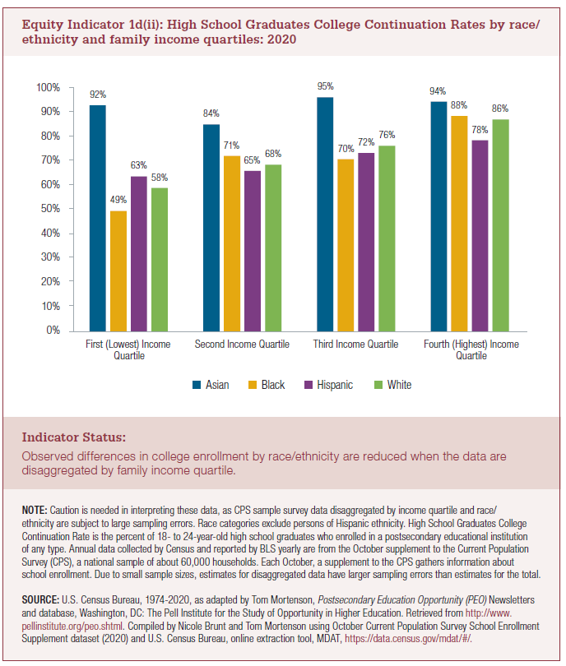
http://pellinstitute.org/indicators/reports_2022_data.shtml

Slide 4
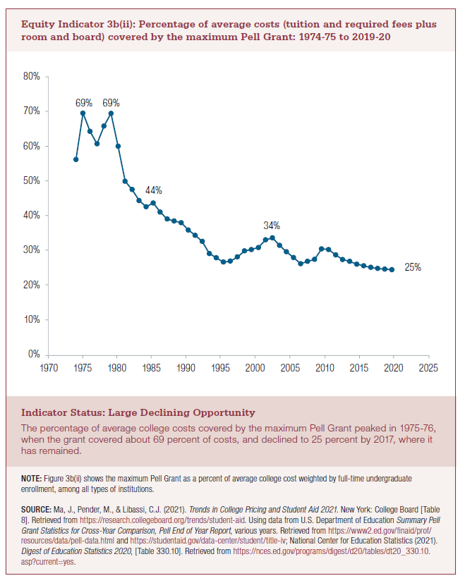
http://pellinstitute.org/indicators/reports_2022_data.shtml

Slide 5
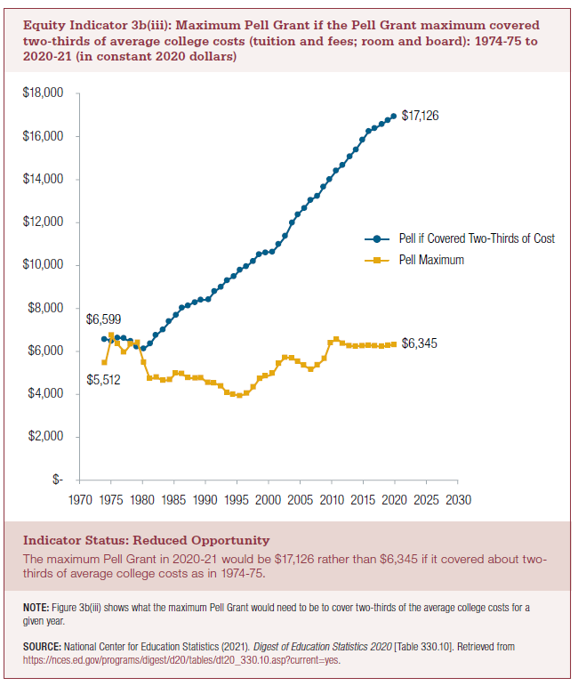
http://pellinstitute.org/indicators/reports_2022_data.shtml

Slide 6
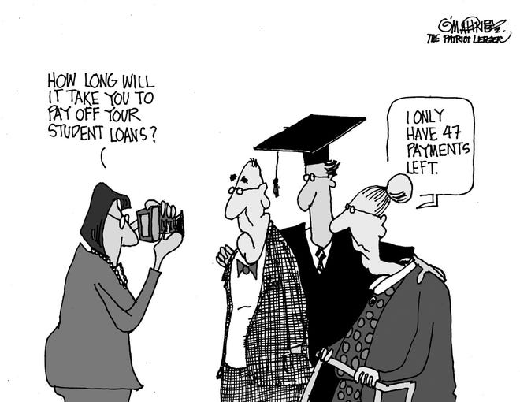

Slide 7
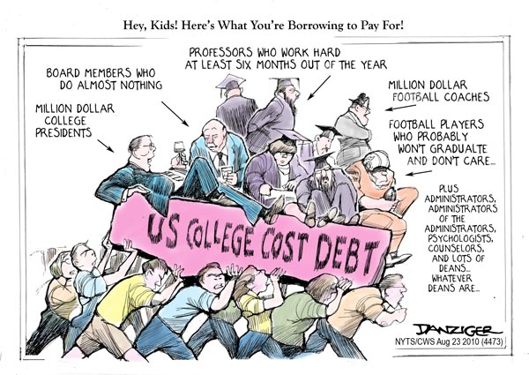

Slide 8
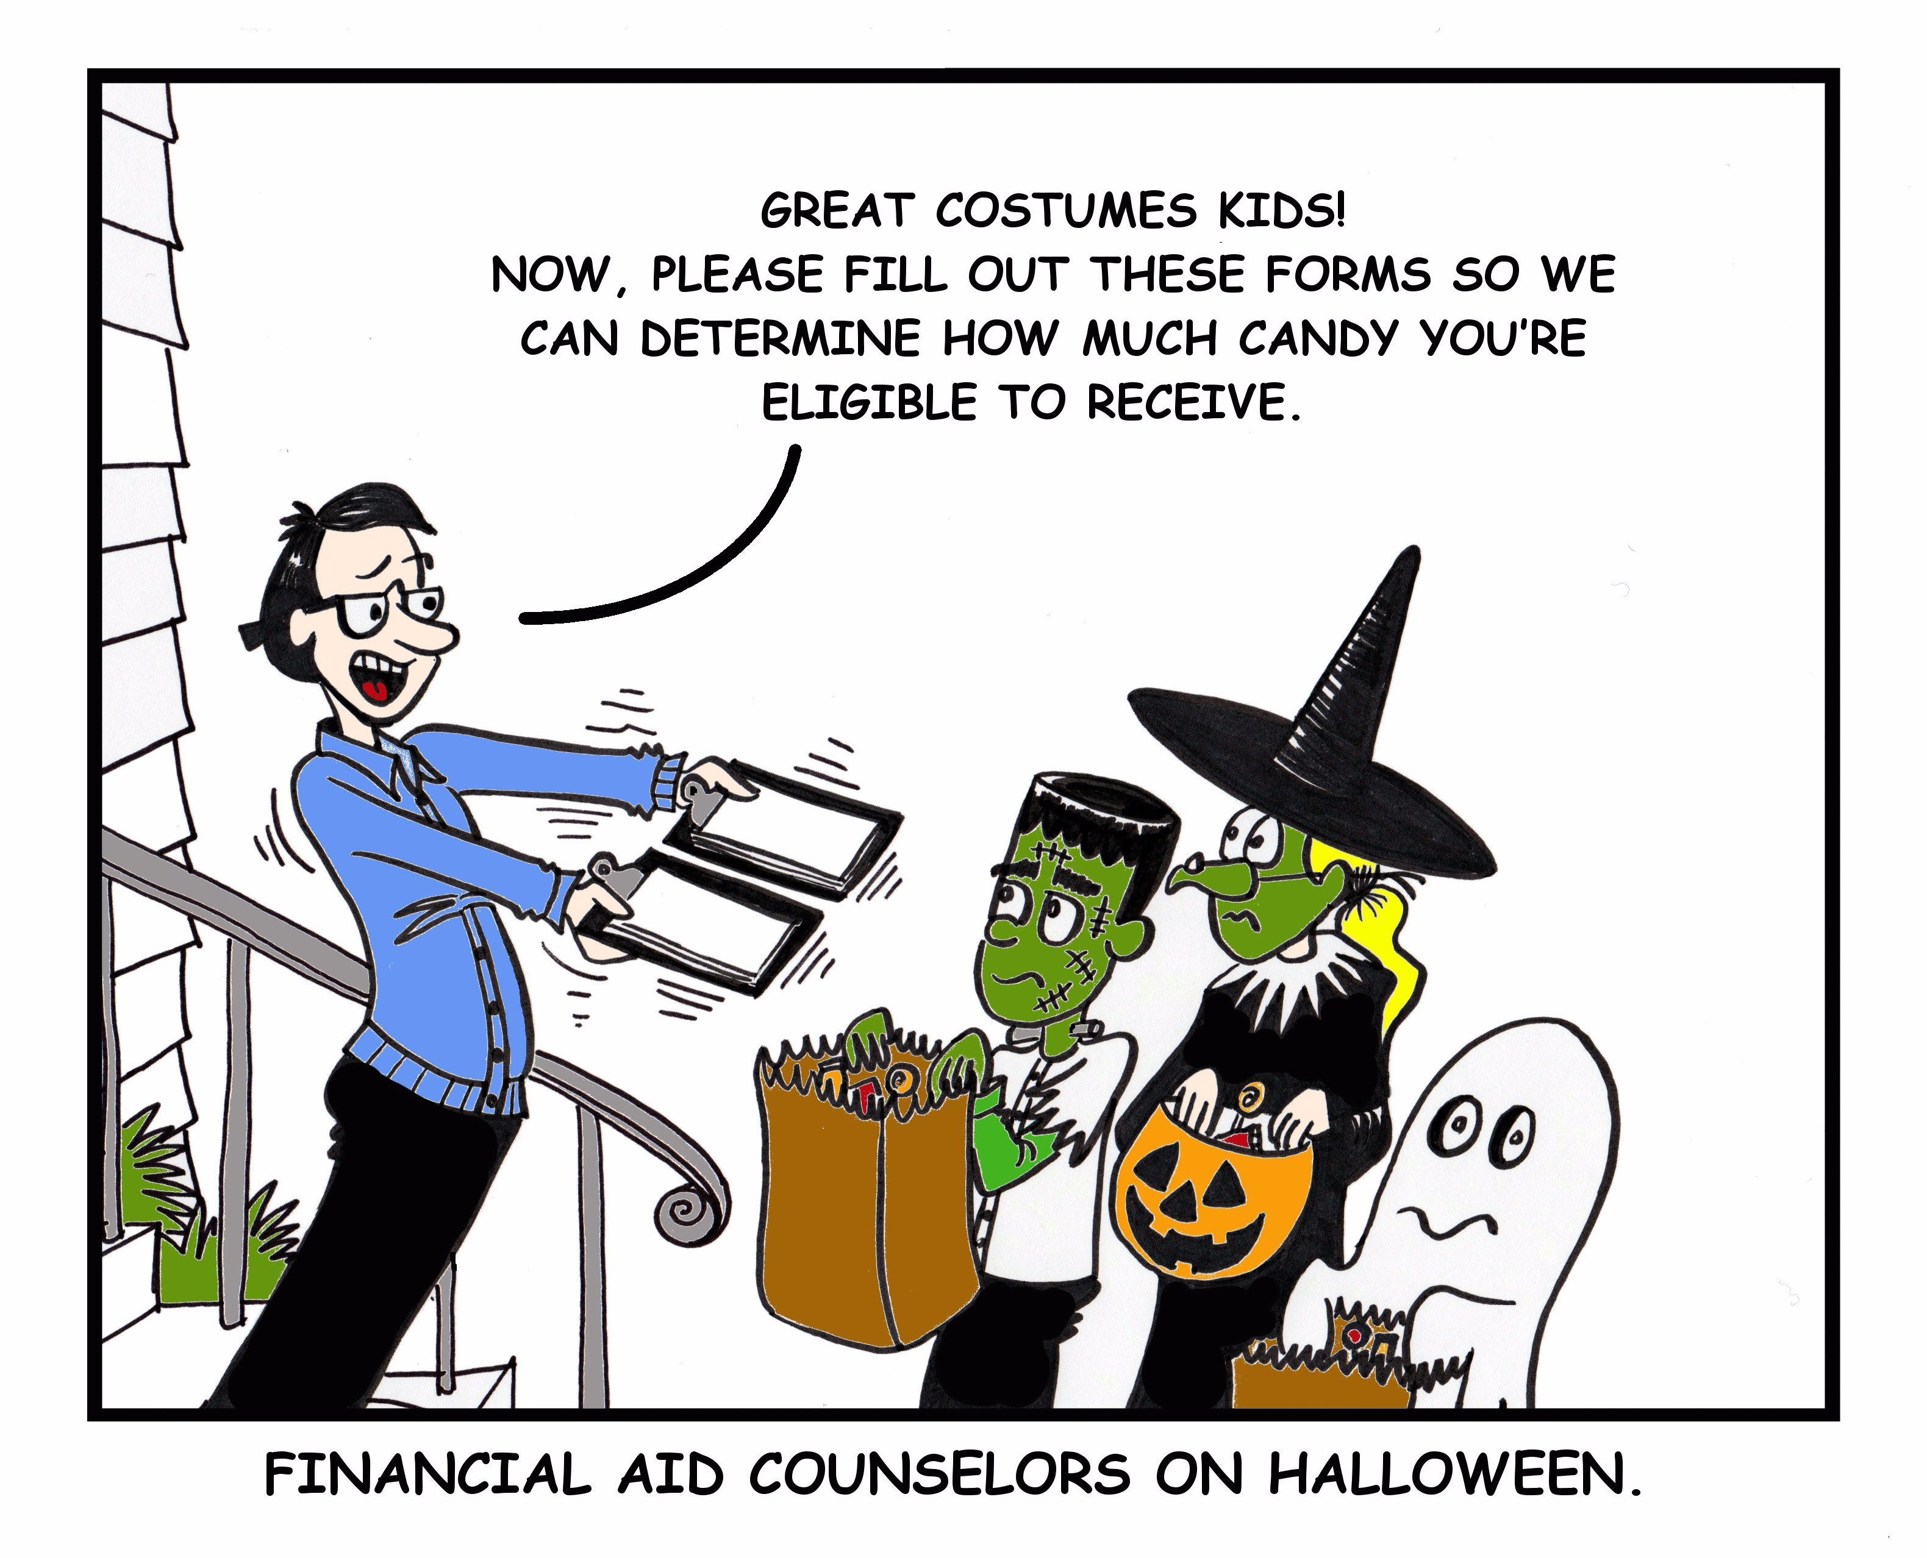

Slide 10
How is student success defined in higher education?
A favorable, positive or desirable student outcome
A holistic phenomenon that embraces the multiple dimensions of personal development and the multiple goals of higher education.
Source: Defining Student Success: The Critical First Step in Promoting It (indstate.edu)

Slide 11
How do you measure student success in higher education?
Retention rate
Graduation Rate
Time-to-degree
Post graduation employment
Post graduation wages
Holistic development: Intellectual, social, ethical, emotional, etc

Slide 12
A Framework for Student Success Analytics | EDUCAUSE

Slide 13
How do you measure student success in higher education?
Satisfaction with the experience: academic and social dimensions
Did the institution facilitate attainment of my goal?
Did the experience contribute to my well-being?
Was the experience “worth it”?

Slide 14
A Framework for Student Success Analytics | EDUCAUSE

Slide 15
Institutional Intelligence
Institutional capacity to give each member of the university community autonomous access to all that analytical information of value for the optimal performance of their functions, through specialized and permanent channels (Alcolea Picazo & Pavon de Paula, 2013) Institutional intelligence is, in a sense, a method to combine all our tools to help us make informed decisions and thus guide the institution. It brings together reports, data analytics, and all kinds of information to provide a complete view of the current state of affairs and challenges the institution faces. Builds a solid foundation based on precision and depth, so that plans and decisions are more informed and intelligent, rather than based on assumptions or annecdotes.
Source:https://www.ellucian.com/es/ideas/analitica-de-datos-y-su-vocabulario-aplicado-la-educacion-superior

Slide 16
A Framework for Student Success Analytics | EDUCAUSE

Slide 17
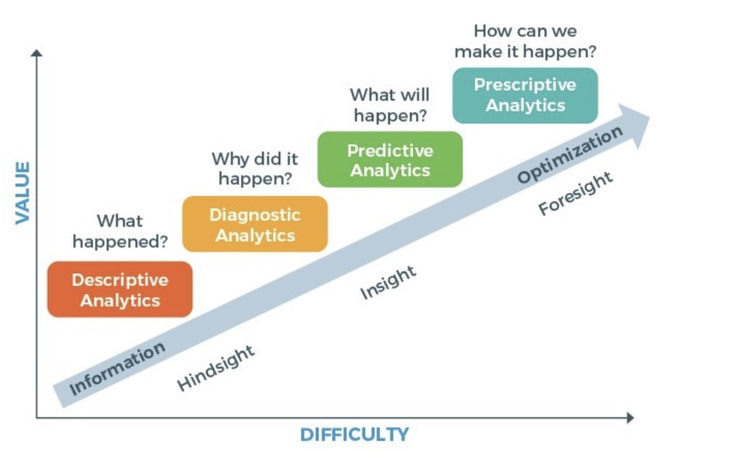
Source: https://research.aimultiple.com/prescriptive-analytics/

Slide 19
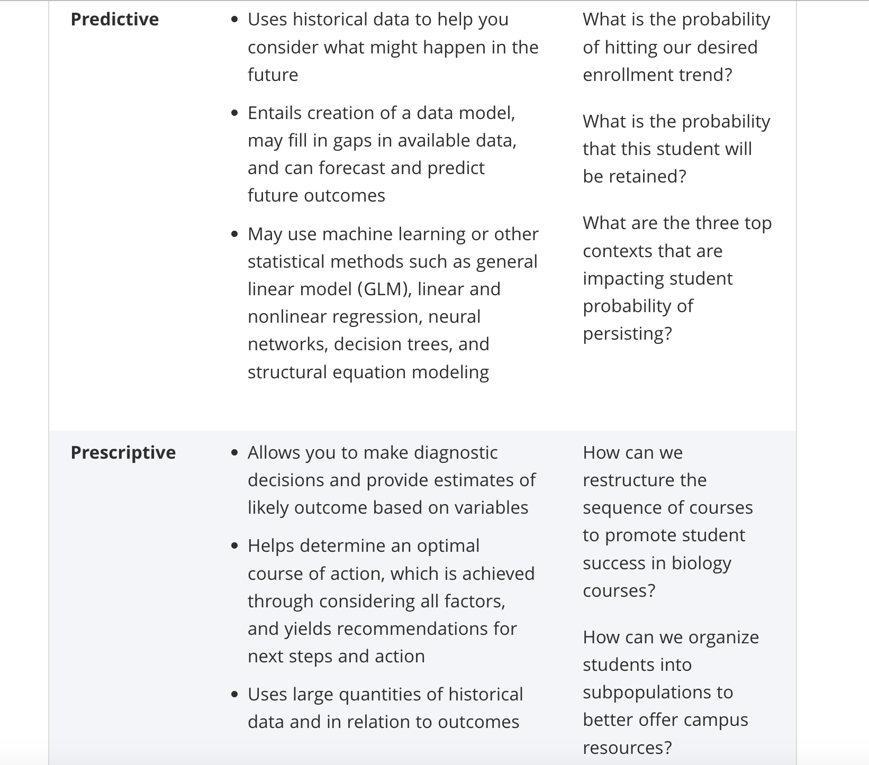

Slide 21
Data and analytics can help institutions understand and respond to shifting demographics among students, including increasing diversity and changes in enrollment patterns. Institutions must be proactive in addressing these changes to ensure that all students have access to the support they need to succeed.
Data and analytics can help institutions fulfill their broader social responsibility by promoting student success and creating pathways to economic and social mobility.
Data and analytics can inform decisions about financial aid leveraging and provide insights into student populations that may be struggling with the cost of attendance. These insights can inform policies and practices that support student success and reduce financial barriers to accessing and completing higher education.

Slide 22
The institutional dimension
Congruent with mission
Reinforces what is working
Changes what is not
Challenges to culture and tradition
Requires introspection
Requires segmentation
Requires change management
Requires courage
“What gets us into trouble is not what we don't know. It's what we know for sure that just ain't so.” ― popularly attributed to Mark Twain

Slide 23
Strategic Questions
What variables impact the behavior of first-entry students in the process of deciding whether or not to enroll in Virginia Tech? How can we use these variables to predict who will register each year and what will be the size of each new cohort? What role does financial aid play in the considerations students and their families take into account when deciding to enroll in college?
How does the success metrics of Test Optional cohorts inform the continuation of the policy? What kind of reports and visualizations can be provided to academic and student support leadership to facilitate decisions regarding course capacity and demand and to use resources strategically to support student performance?
How does curricular complexity influence the ability of students to complete their degree requirments on time?

Slide 24
What variables affect enrollment decisions?
Financial variables
Discount rate- COA divided by institutional aid Family resources- EFC Type of financial aid
Academic variables
Grade point average test score/ noncognitive scores Interest in specific academic areas
Geo-demographic variables
Place of residence Parents' schooling history Ethnic characteristics
Variables related to events and visits
Attended an event on the university campus Made an individual visit Attended an event of a specific college

Slide 25
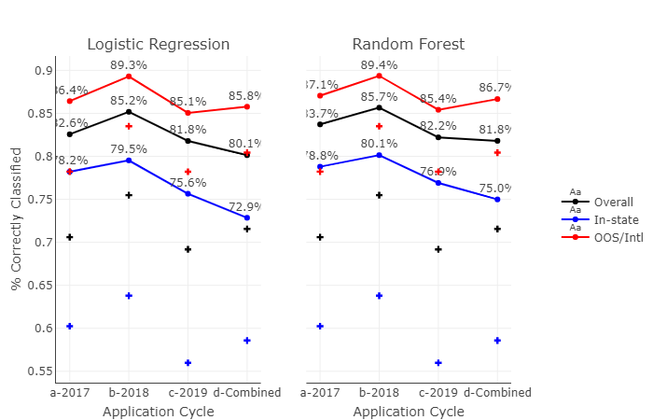
Predicting who enrolls
Classification accuracy
Predictive analytics uses historical data to predict future events and create a mathematical model that captures important trends. This predictive model is then used with the current data to predict what will happen next, or to suggest actions to be taken in order to obtain optimal results. It involves applying statistical analysis techniques, analytical queries, and machine learning algorithms to datasets to generate a numerical value that represents the probability of a particular event occurring.

Slide 26
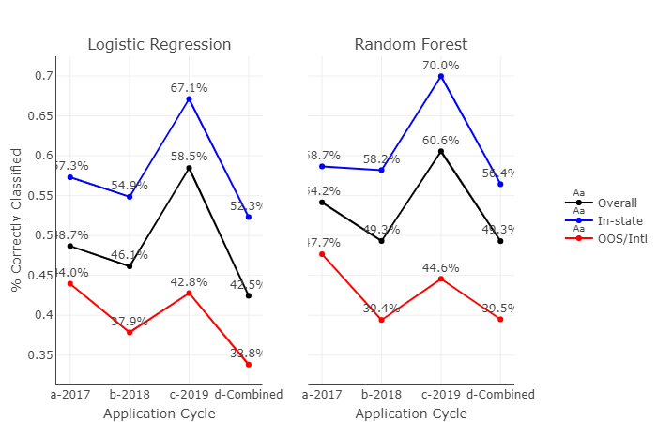
Predicting who enrolls
Sensitivity: true positives
The variables are combined into a predictive model capable of assessing future probabilities with an acceptable level of fidelity. Logistic regression and random forest technique were chosen for our intial model effort
Notes:
Random forest (o random forests) también conocidos en castellano como '"Bosques Aleatorios"' es una combinación de árboles predictores tal que cada árbol depende de los valores de un vector aleatorio probado independientemente y con la misma distribución para cada uno de estos. Es una modificación sustancial de bagging que construye una larga colección de árboles no correlacionados y luego los promedia.

Slide 27
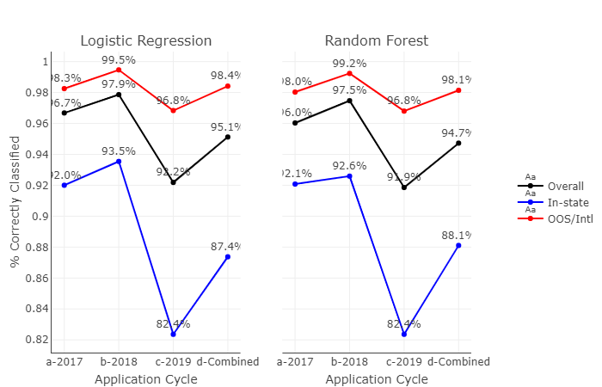
Predicting Who Enrolls
Precision: True negatives
Optimization measures in each population, better predicting the behavior of students outside the state of Virginia The model is accurate in predicting who will not enroll

Slide 28
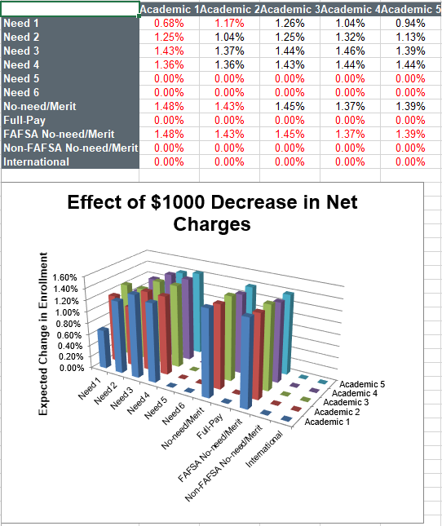
Calculating the Effect of Financial Aid
Generalized linear model used to determine the effect of reducing tuition costs by $1,000 increments Considers the ability to pay tuition It also takes into account the willingness to pay the indicated price Helps decide which groups to invest in to achieve a specific objective Especially useful when there aren't many resources to invest

Slide 29
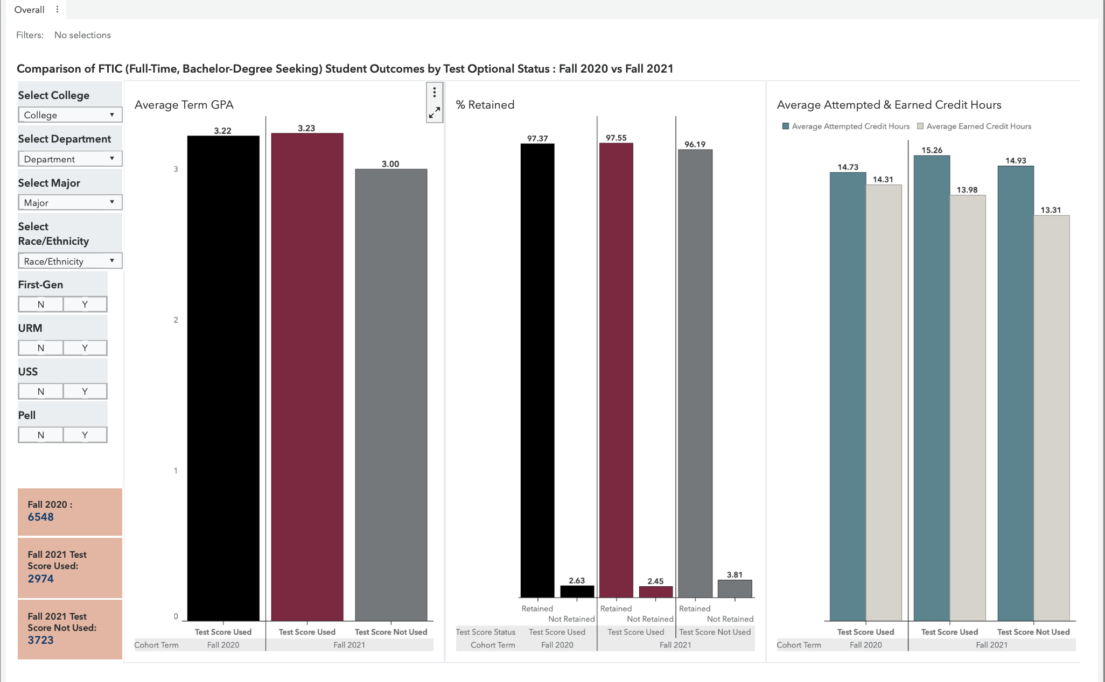
Test Optional Student Performance

Slide 30
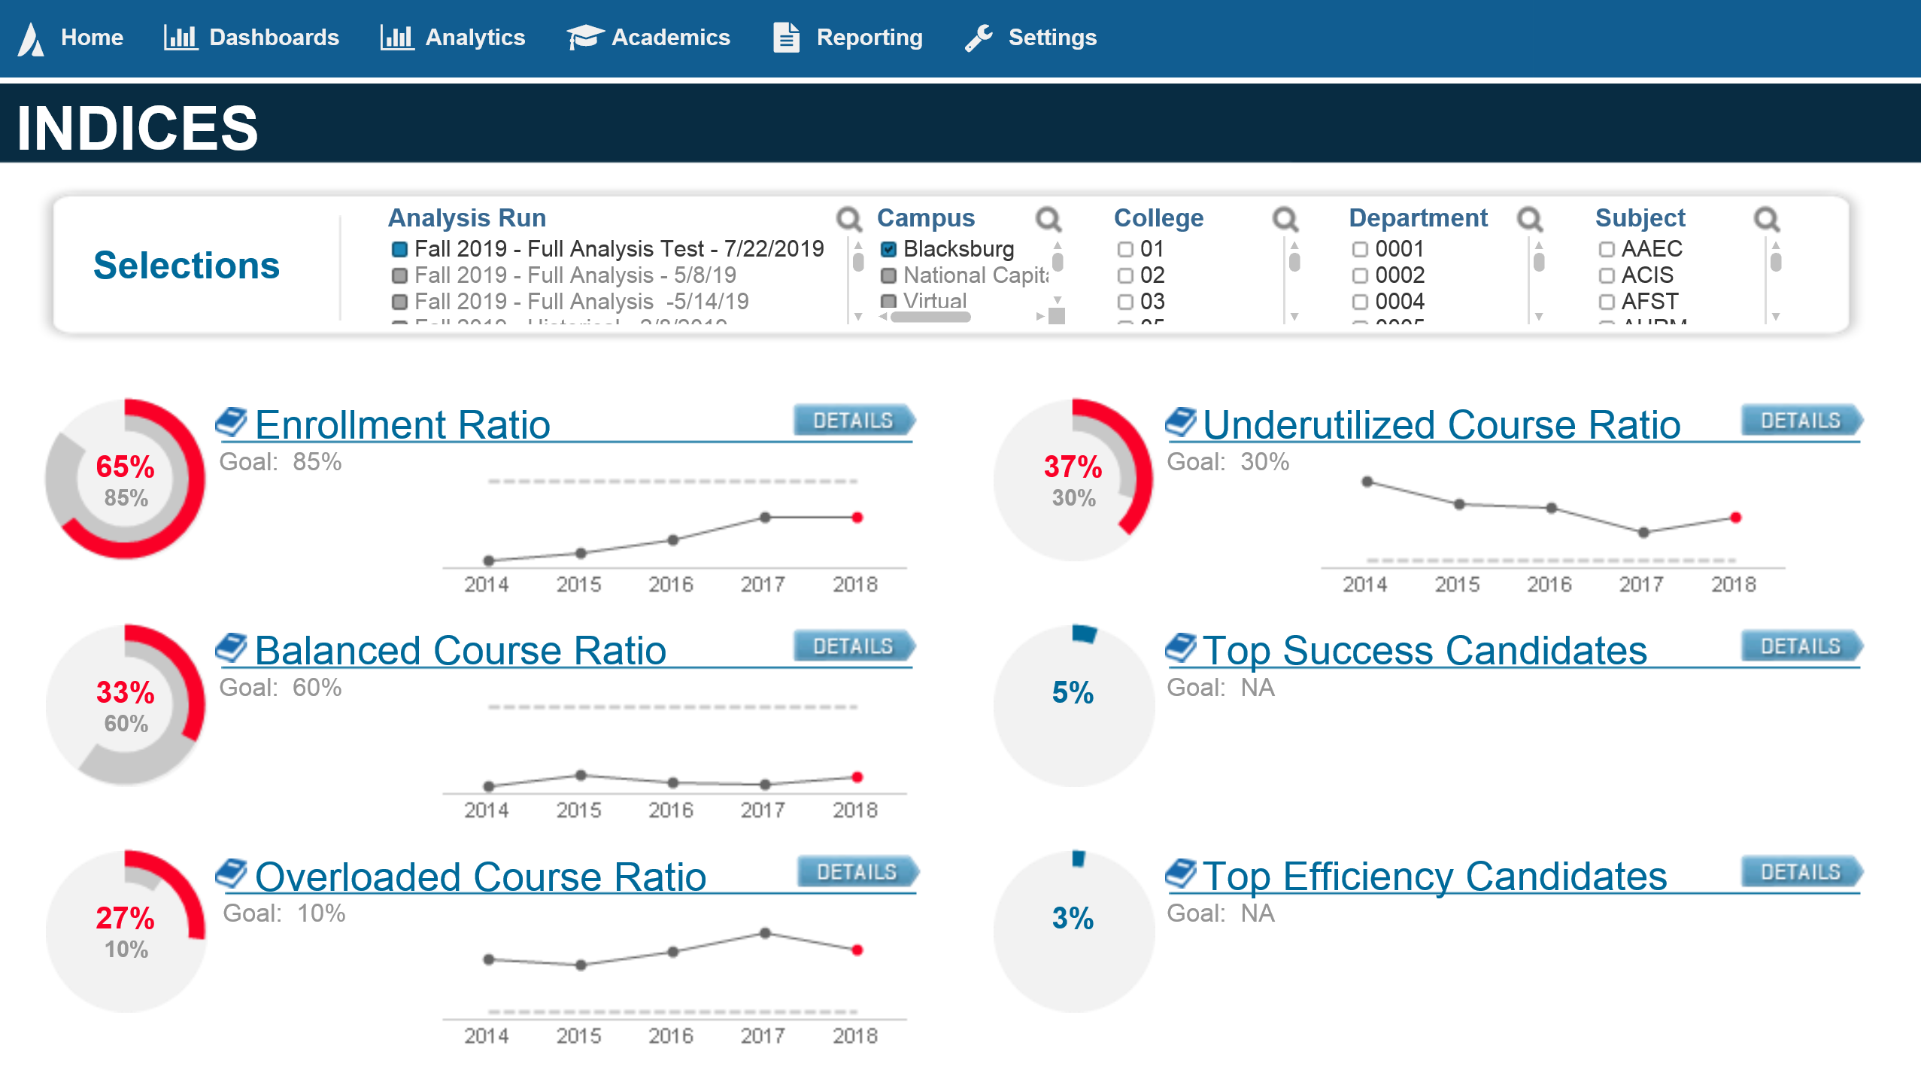
Capacity and Demand

Slide 31
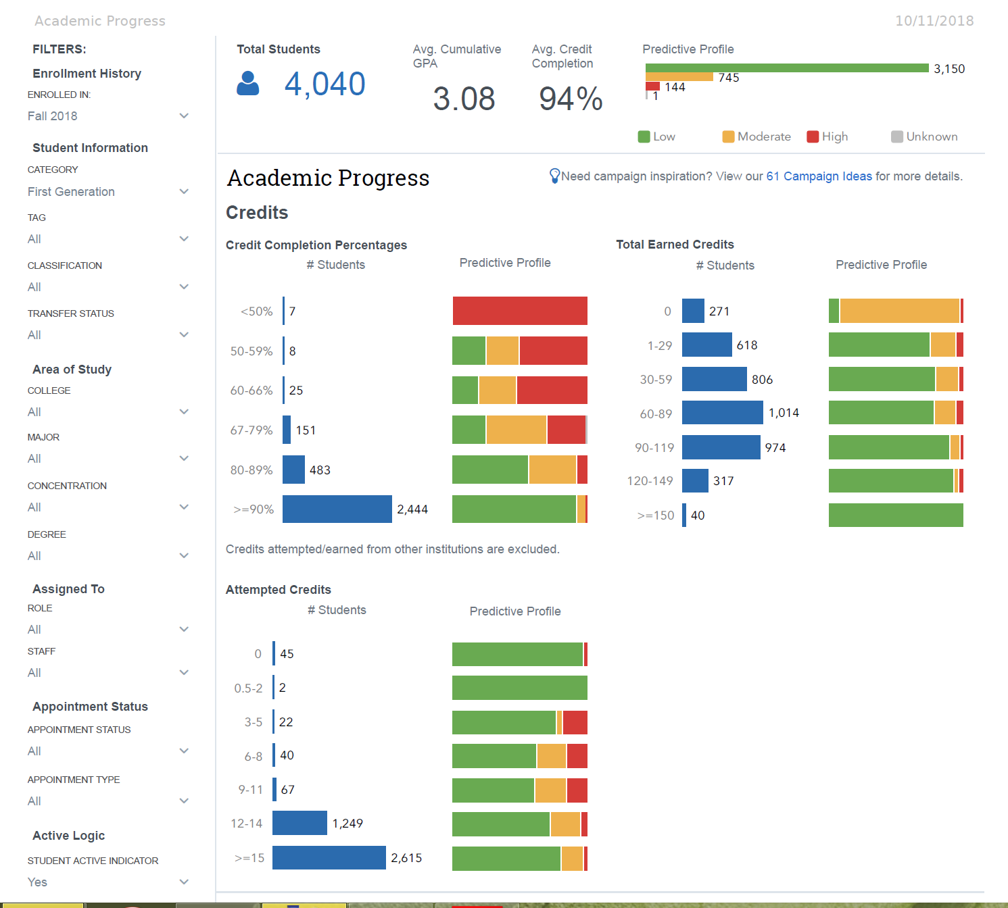
Supporting Student Success

Slide 32
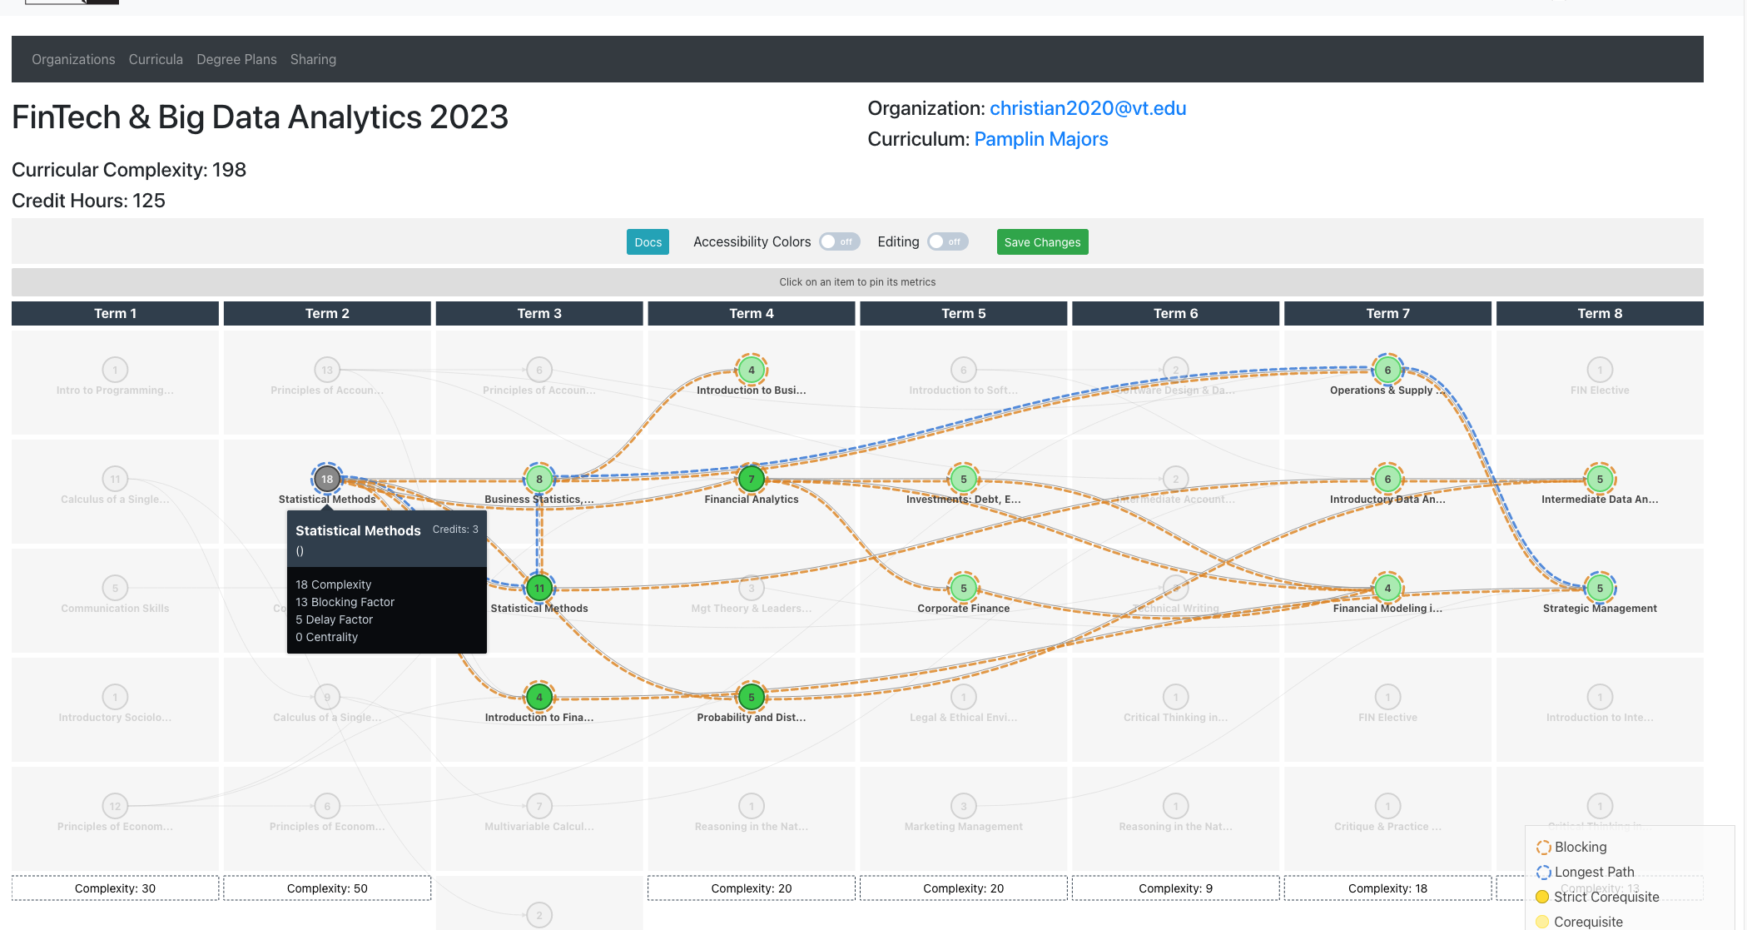
Understanding how curricular complexity affects success

Slide 33
Most Common Challenges
» Sponsorship of the highest level » Constraints on required resources » Understanding existing processes
» Quality and integrity of existing data » Understanding and managing internal expectations
» Culture resistant and unwilling to change » Complexity in data integration » Training » Justification of return on investment » Departmental silos.

Slide 34
Implementation Benefits
» Promote and foster a fact-based culture for decision-making » Monitor the performance of university management to achieve defined objectives » Establish a proactive framework for decision-making
» Access data instantly, spend your time analyzing information and understanding its implications instead of collecting and formatting data. » Facilitate the articulation and alignment of strategies throughout the institution » Anticipate and manage change.
Adaptado de https://www.incae.edu/es/blog/2016/07/01/retos-y-beneficios-del-business-intelligence.html

Slide 35
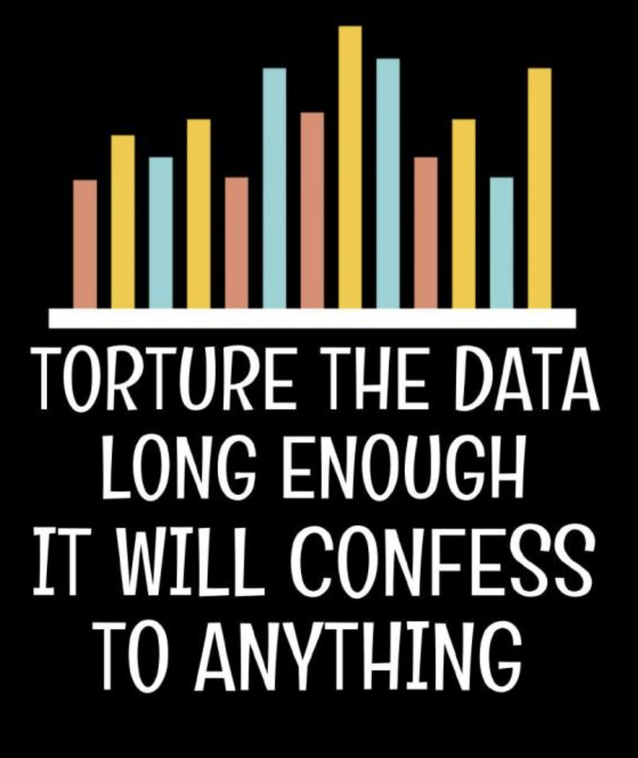
Ethical Considerations
Just because we can, doesn’t automatically mean we should
Bias awareness, mitigation and monitoring
Transparency vs privacy
Governance
-Ronald Coase (1991 Nobel Prize in Economics)

Slide 36
Based on the principles of the Asilomar Convention, a document attempting to guide ethical decision-making in advancing higher education research.
Do No Harm: To ensure that decisions based on analytics do not inadvertently harm students, thoughtfully consider any areas that are prone to missteps. Keep in mind that not using analytics for fear of causing harm (either to the institution or the students) is not a viable option.
Respect for Students: Transparency around data use and analytics is a foundational step toward demonstrating respect and building trust among students and other stakeholders. Without the trust of students and colleagues, your ability to capitalize on data to help students achieve their goals will be constrained.
https://www.edweek.org/education/opinion-the-asilomar-convention-revisiting-research-ethics-and-learning-science/2014/06

Slide 37
Accountability: As your institution's data capabilities expand, so does the need for accountability measures that aid in the ethical assessment of tools, strategies, and actions. Accountability structures should include the voices of various stakeholders—students, staff, faculty, and administrators. Consider forming, for example, a student success analytics group on campus. The creation of a team approach can help to break down data silos and build trust.
Autonomy, Privacy, and Equity: The goal in an analytics initiative is to leverage data to help students achieve success while also respecting their personal autonomy, protecting their privacy, and ensuring equity.

Slide 38
TO SOLVE BIG PROBLEMS, FOCUS ON SMALL WINS
KARL E. WEICK

